Slide 1
Digital Control System Analysis and Design
Chap. 1 Introduction
Chap. 2 Discrete Time Systems and the z-Transform
Chap. 3 Sampling and Reconstruction
Chap. 4 Open-Loop Discrete-Time Systems
Chap. 5 Closed-Loop Systems
Chap. 6 System Time-Response Characteristics
Chap. 7 Stability Analysis Techniques
Chap. 8 Digital Controller Design

Slide 2
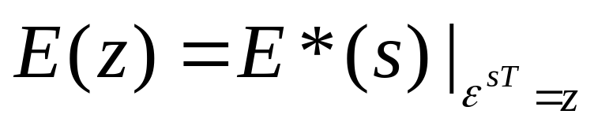
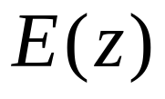
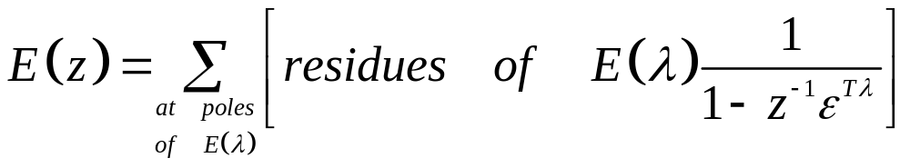
4.2 The Relationship Between E(z) & E*(s)
Defined:
then
(4-3)
can be calculated

Slide 3
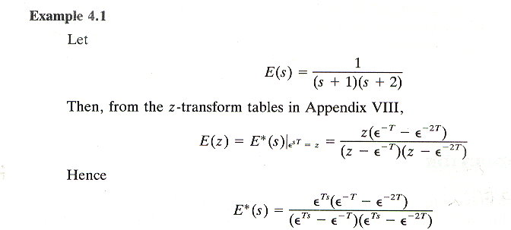
Example 4.1 vs. Example 3.3
Compared with Example 3.3 via (3-10)
The 4th method to evaluate E*(s).
i.e. Eq (3-7), (3-10), (3-11), and (4-3)

Slide 4
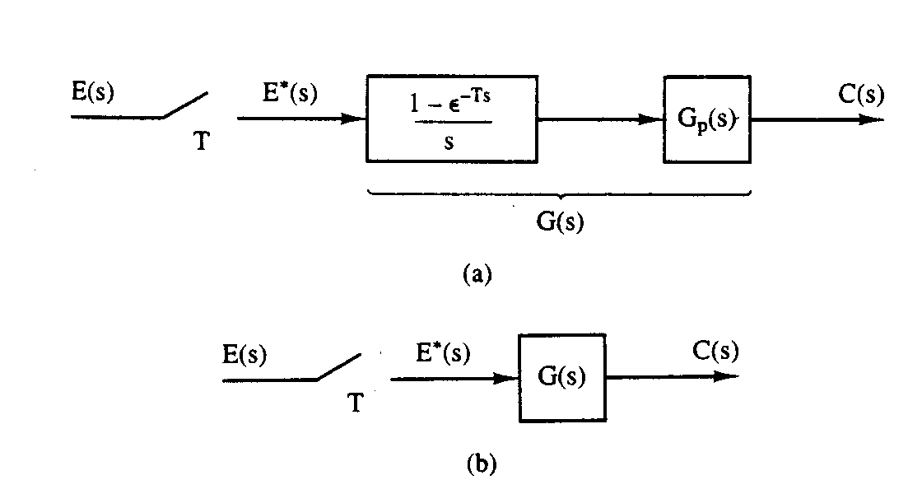
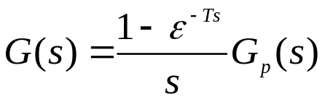

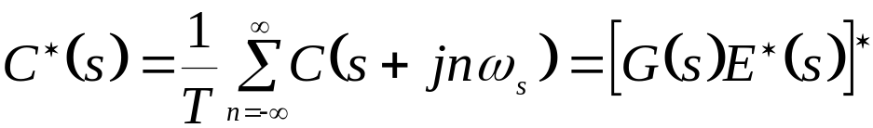
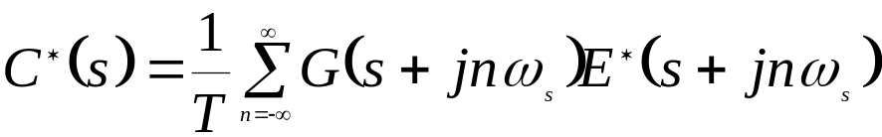
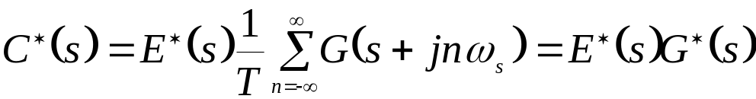

4.3 The Pulse Transfer Function
Figure 4-1 Open-loop sampled-data system.
G(z) is the pulse TF: I/O relation at the sampling instants.

Slide 5
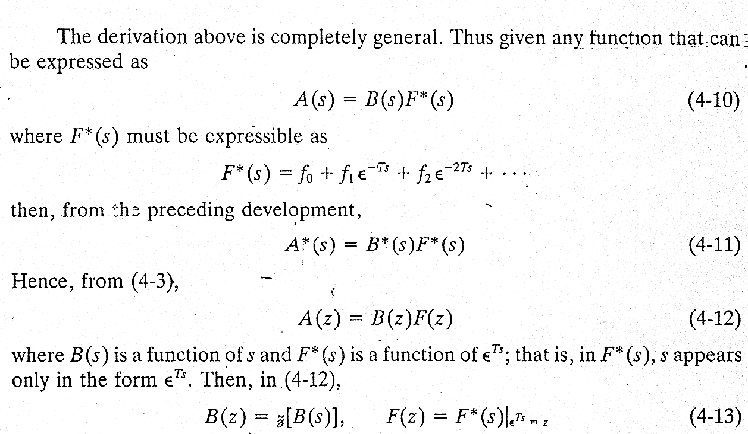
F(s)
F*(s)
A(s)
B(s)

Slide 6
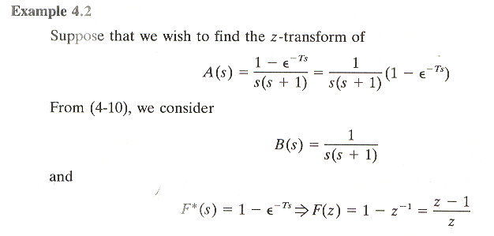
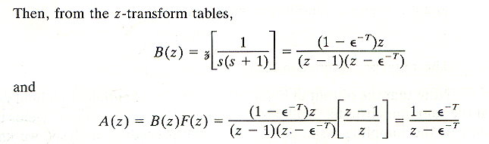

Slide 7
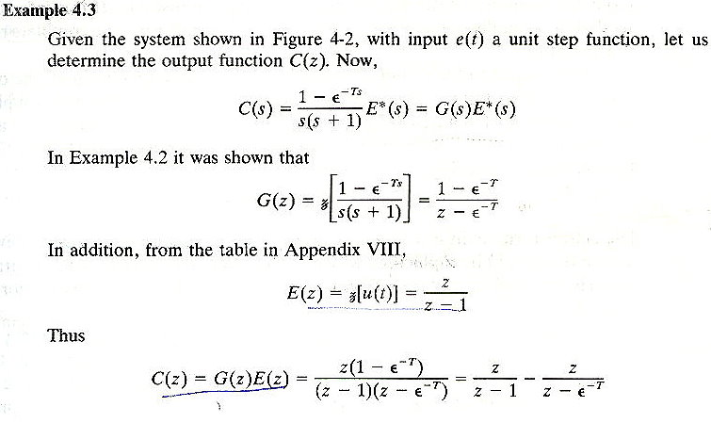
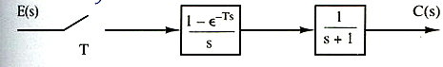

Slide 8
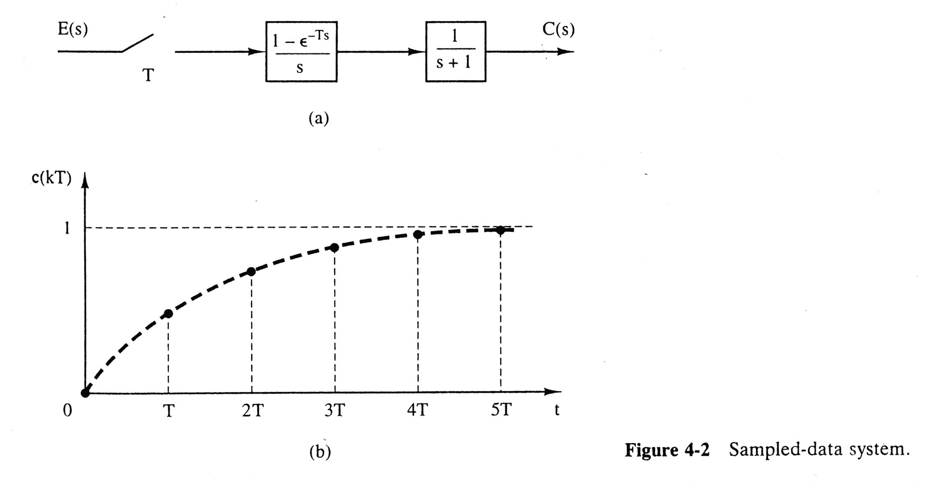
c(t) → c(nT): OK (sampling)
c(nT) → c(t): NG (need the data reconstruction)

Slide 9
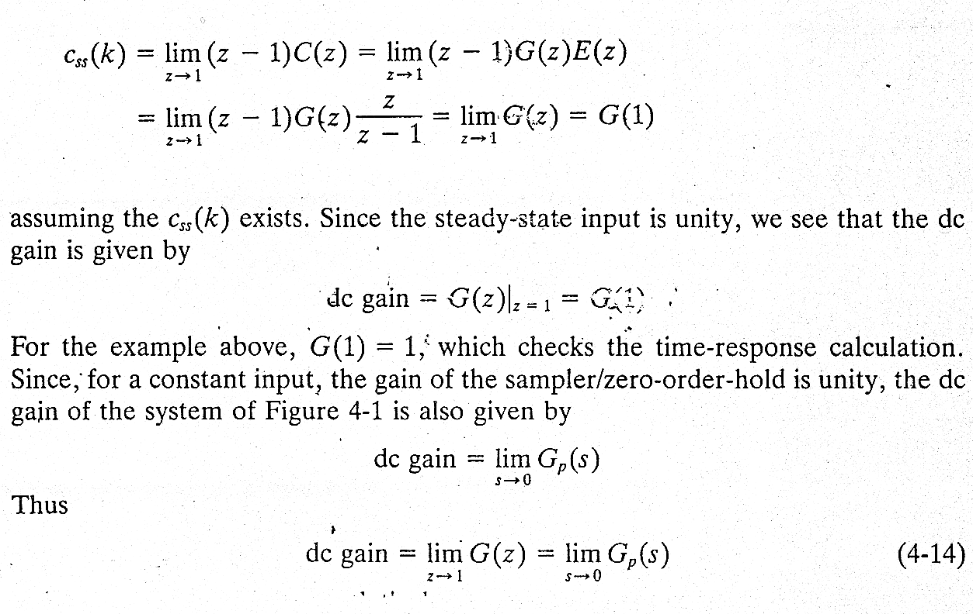
dc gain
A constant input of unity
From S-domain viewpoint
(w/o sampler and ZOH)

Slide 10
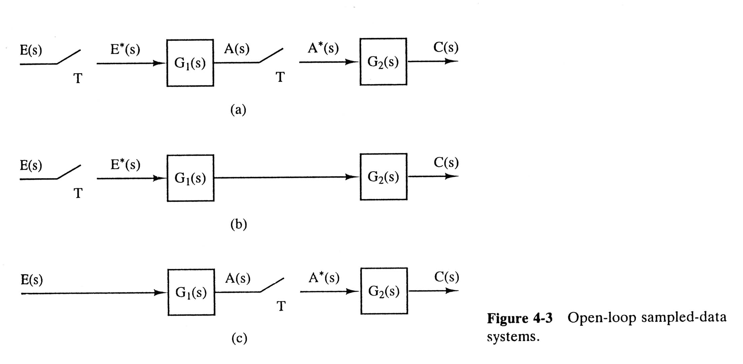
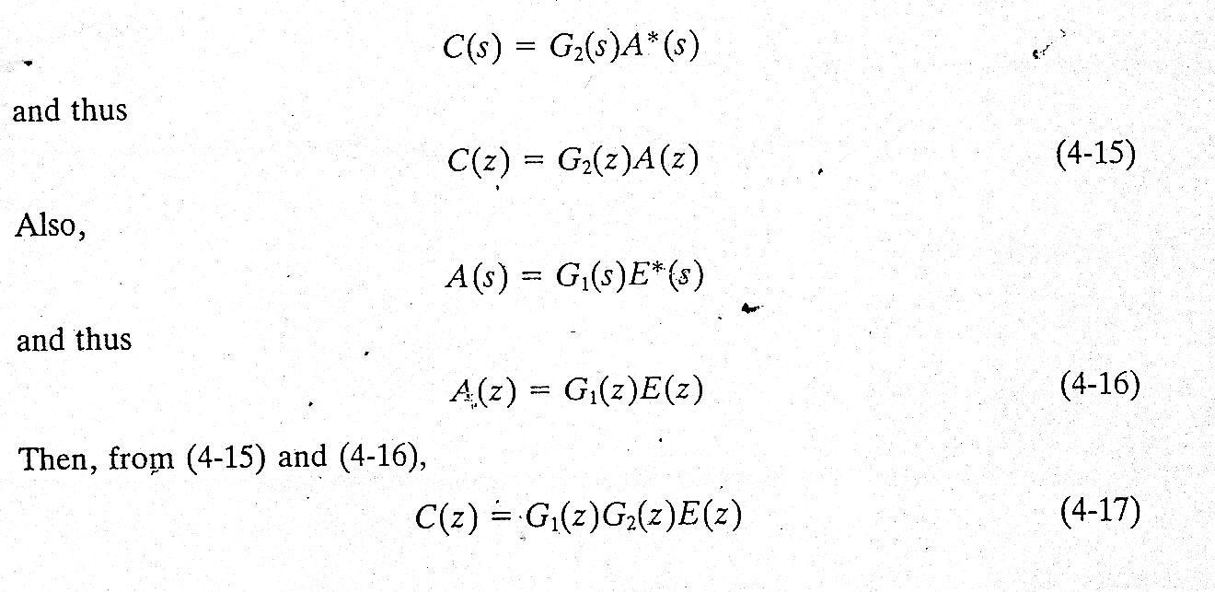
Fig. 4.3 (a)

Slide 11
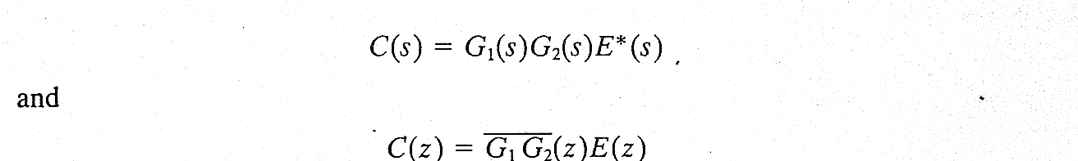
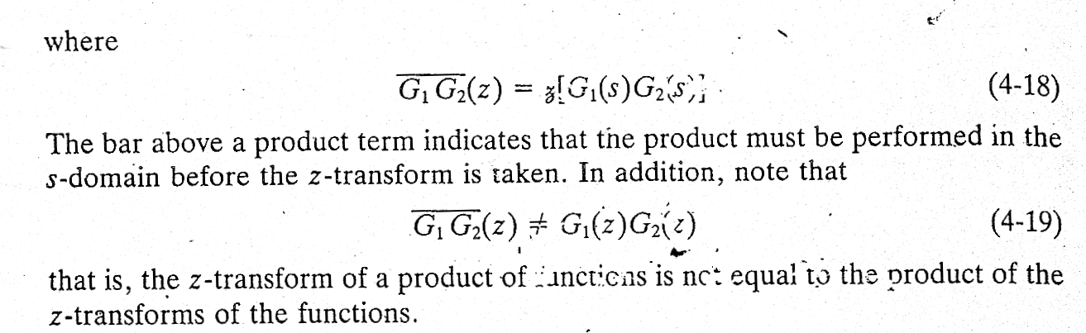
Fig. 4.3 (b)

Slide 12
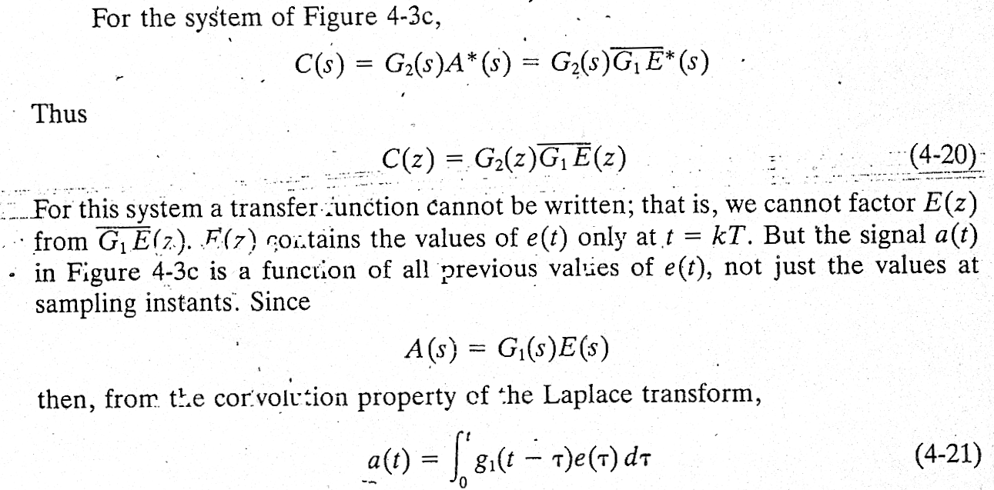
Fig. 4.3 (c)

Slide 13
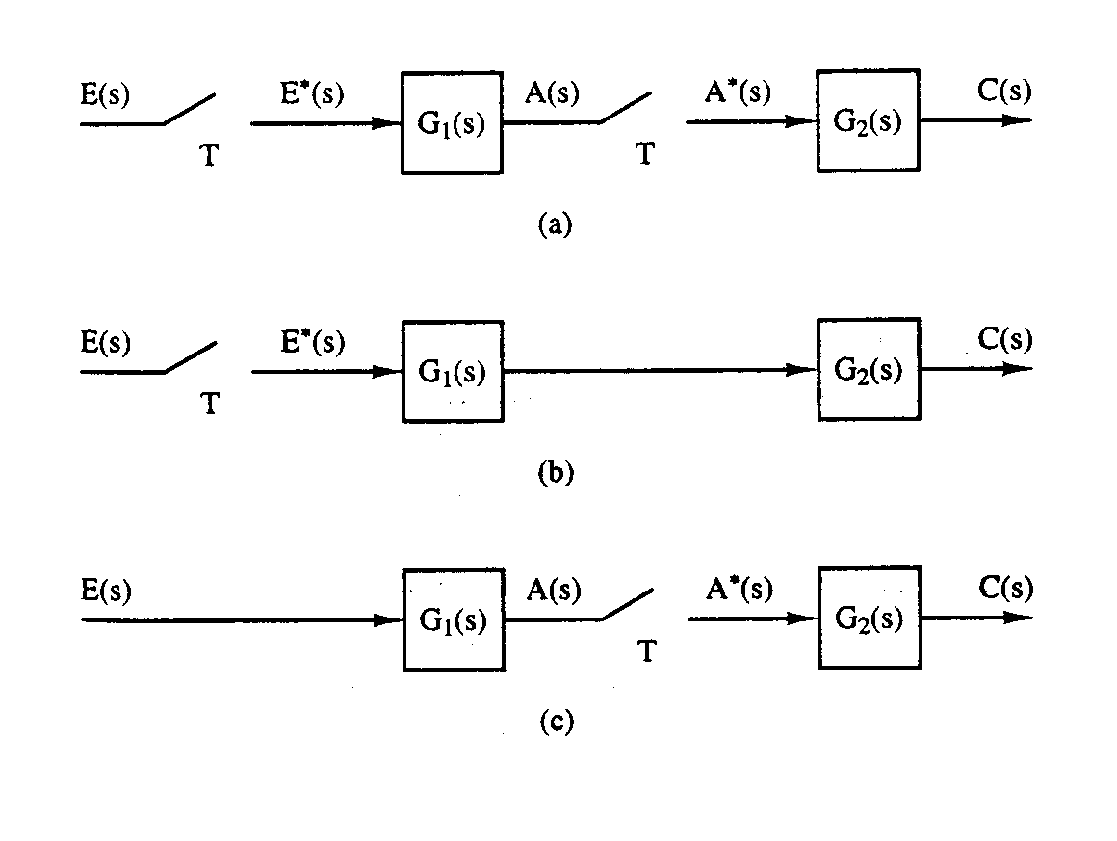








Summary
Figure 4-3 Open-loop sampled-data systems.
For 4.3(a)
then
For 4.3(b)
Would not contain a data-hold transfer function
For 4.3(c)

Slide 14
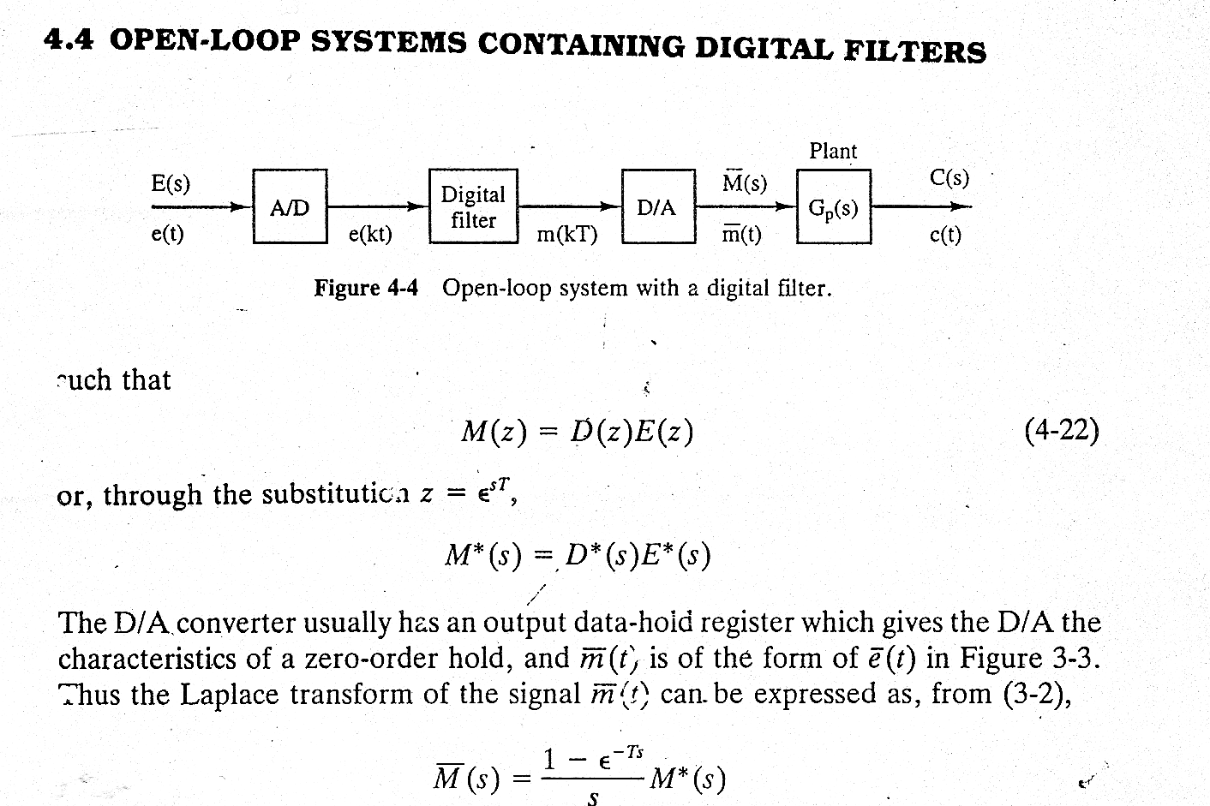
4.4 Open-Loop Systems Containing Digital Filters
D(z)
G(z)
E(z)
M(z)
e(kT)

Slide 15
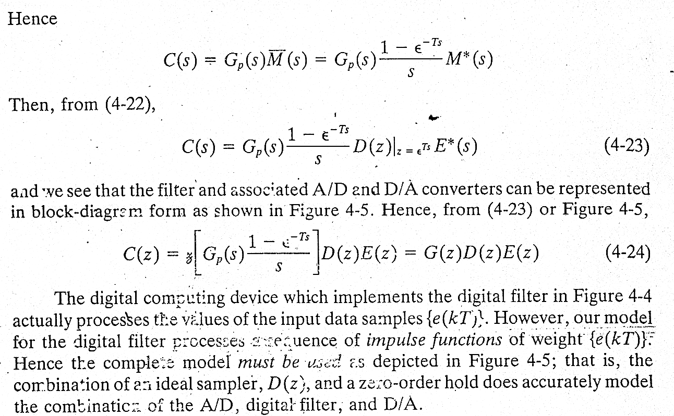

Slide 16
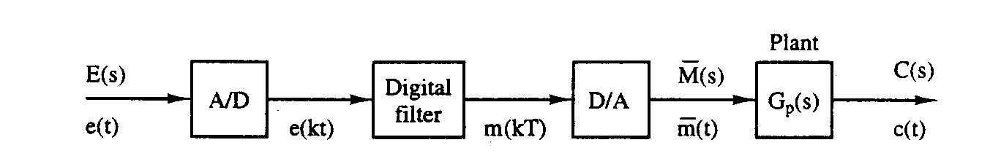

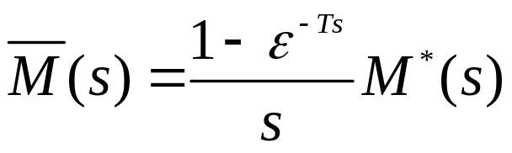
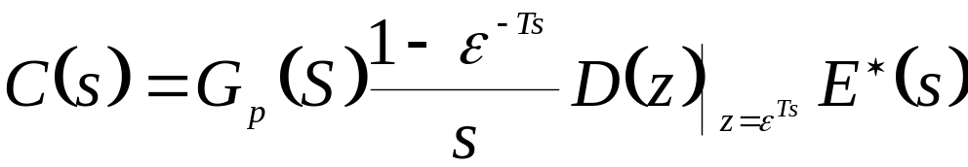
Summary
E(z)
E*(s)
D(z)
M(z)
M*(s)
Figure 4-4 Open-loop system with a digital filter.
G(z)
Such that
then
⎡
1
−
ε
−
Ts
⎤
C
(
z
)
=
z
G
(
s
)
D
(
z
)
E
(
z
)
=
G
(
z
)
D
(
z
)
E
(
z
)
⎢
⎥
⎣
p
s
⎦

Slide 17
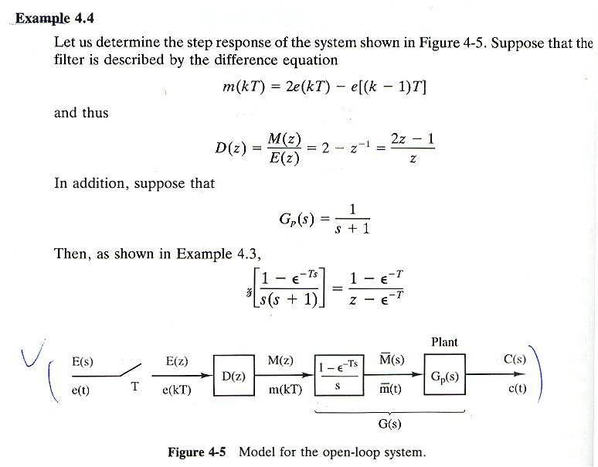
Digital filter

Slide 18
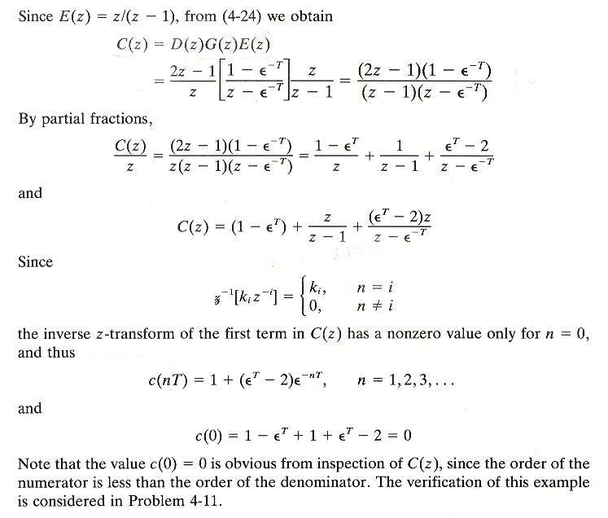
Sol.之另一表示:
c(nT)= (1-ε^{T})δ(n) + 1 +
(ε^{T}-2) ε^{− nT}
Step resp.

Slide 19
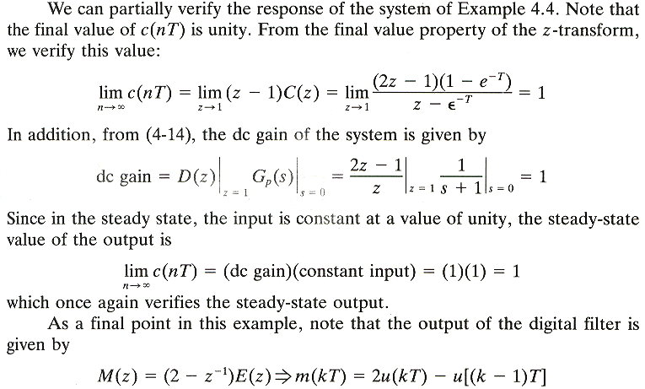
Steady-state output of unity.

Slide 20
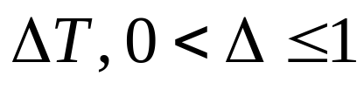
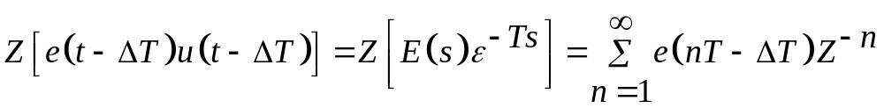
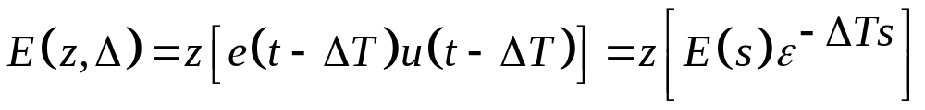
4.5 The Modified z-transform
Ideal time delays:
Ordinary z-transform of the delayed time function is
-△Ts
(4-25)
Delayed z-transform
(4-26)

Slide 21
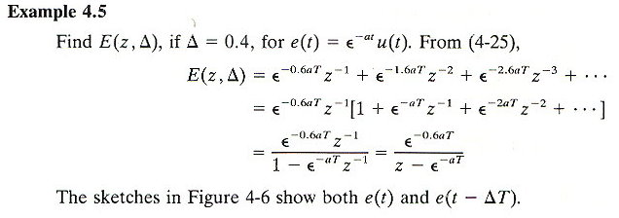
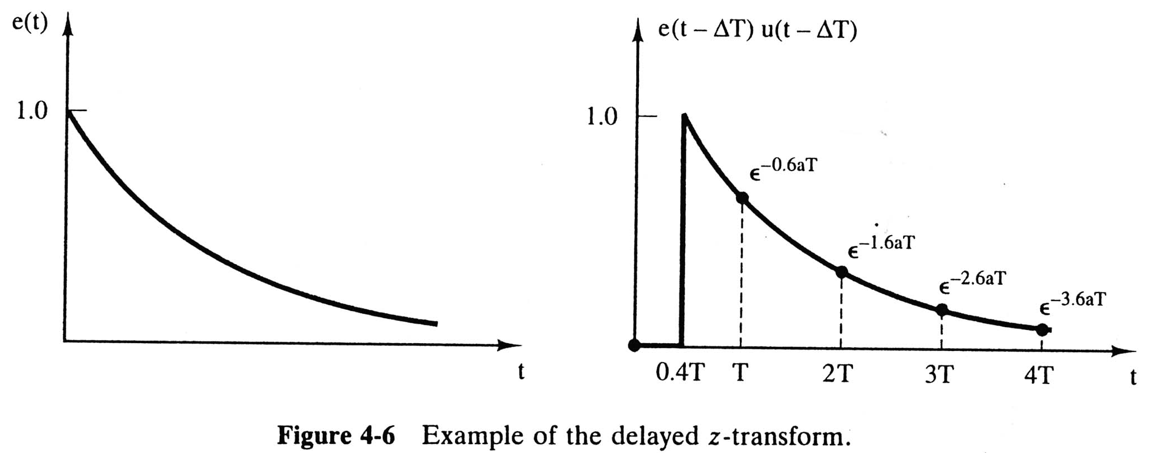

Slide 22
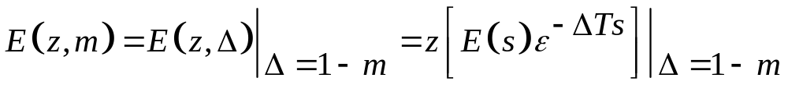
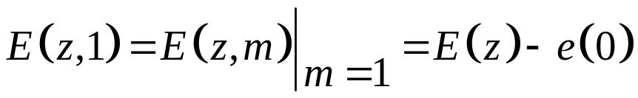
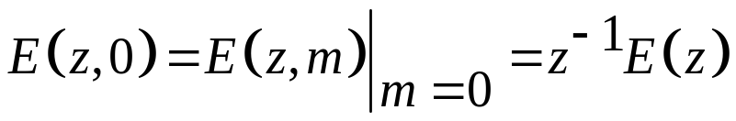
Delayed z-transform
(4-26)
Modified z-transform
(4-27)
Appendix VIII (the rightest column)
Two properties of the modified z-transform are
No delay
(4-29,30)
A delay of
one sample period, T

Slide 23
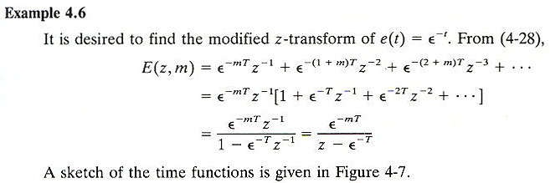
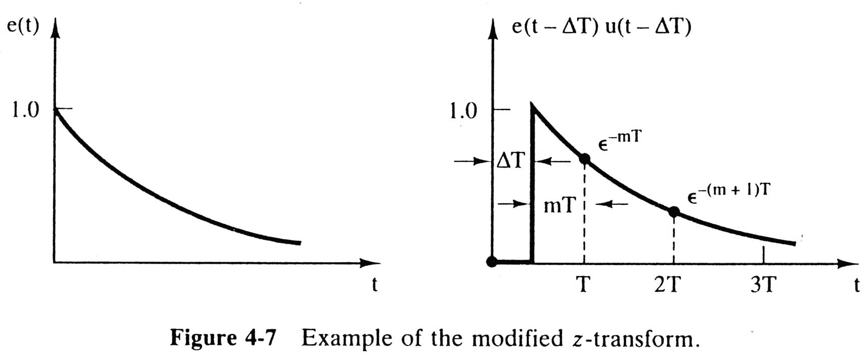

Slide 24
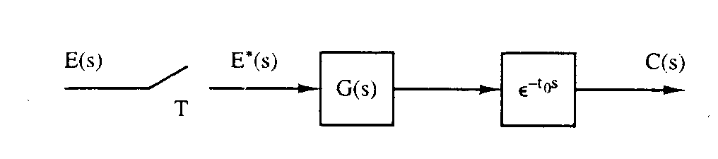
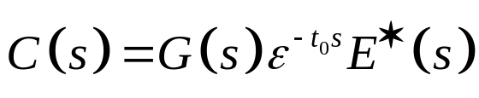
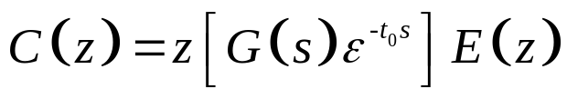


4.6 Systems with Time Delays
Figure 4-8 System with ideal time delay.
Ideal time delay of t₀ sec.
k is a positive integer
Let
(4-39)

Slide 25
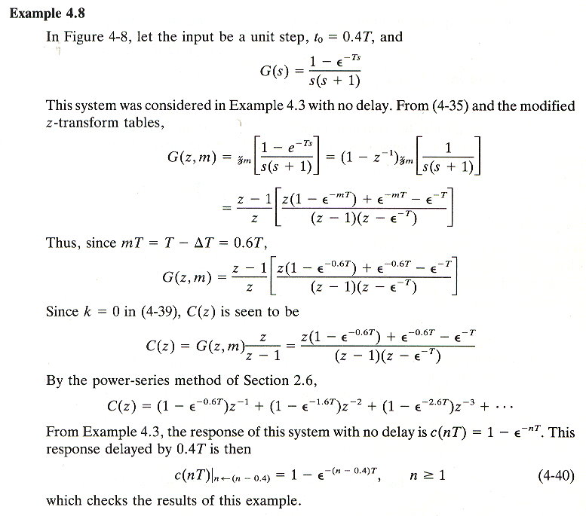

Slide 26
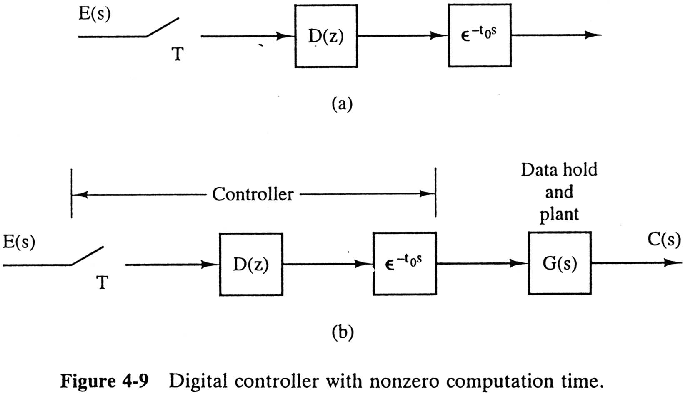
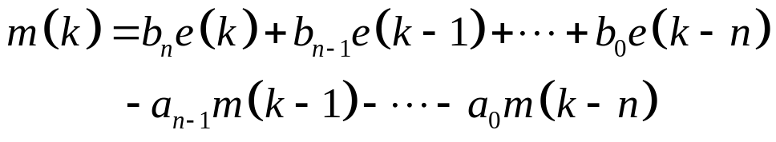
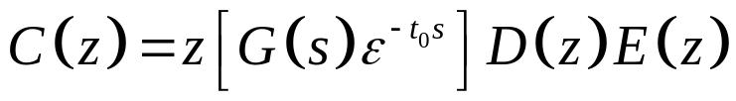


Compu. time
Time Delay of Digital Controller
(4-41)
(4-44)

Slide 27
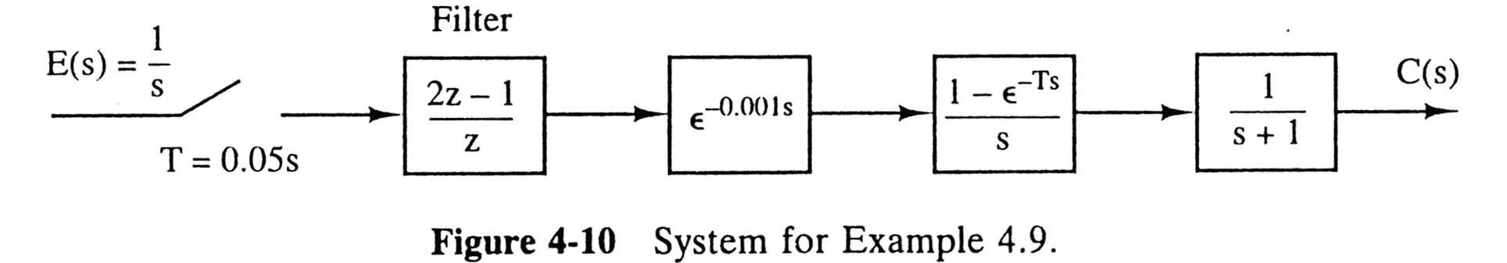
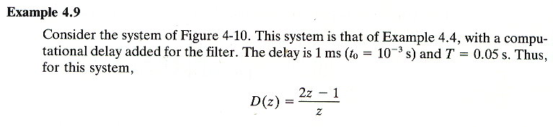
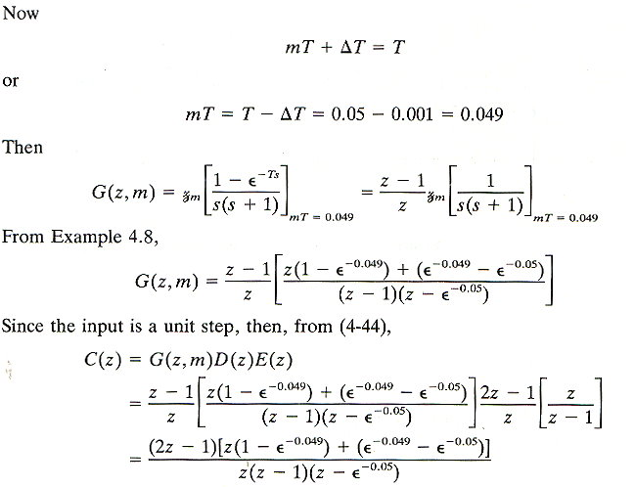

Slide 28

4.7 Non-Synchronous Sampling
Both samplers operate at the same rate, but are not synchronous.

Slide 29


(4-45)
Special case: hT=0 → Ch3 Eq. (3-1)

Slide 30



-hTs
(4-46)
(4-47)
Fig. 4-12 (a))
E(s)
E(s)
Delay the input
Advance the delayed sampled signal
The total delay in the signal is zero.

Slide 31







Slide 32


Example 4.10
Non-Synchronous sampling
hT

Slide 33


Slide 34
See Summary (P161)
Problems: 4-1, 4-2, 4-7, 4-10(a)
4-13, 4-19(a), 4-20(a)
Test Bank

